Slide 1
Virtualization Technologies
CPSC 454 Cloud Computing & Security
Portions of this PPT draw from PPT authored by Professor Dijiang Huang at
Arizona State University

Slide 2
Outline
Virtualization Concepts and Classifications
I/O Virtualization
VMM (Virtual Machine Monitor)

Slide 3
Virtualization Concepts and Classification

Slide 4
Virtualization: What is it, really?
Real vs. Virtual
Similar essence, effect
”Formally” different
A framework that combines or divides [computing] resources to present a transparent view of one or more environments
Hardware/software partitioning (or aggregation)
Partial or complete machine simulation
Emulation (again, can be partial or complete)
Time-sharing (in fact, sharing in general)
In general, can be M-to-N mapping (M “real” resources, N “virtual” resources)
Examples: VM (M-N), Grid Computing (M-1) , Multitasking (1-N)

Slide 5
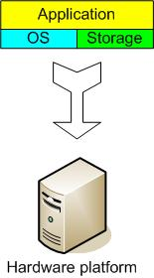
The Traditional Server Concept
Web Server
Windows
IIS
App Server
Linux
Glassfish
DB Server
Linux
MySQL
EMail
Windows
Exchange

Slide 6
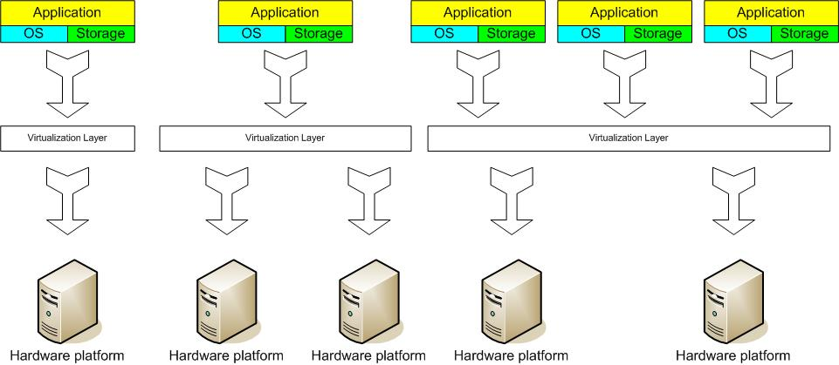
The Virtual Server Concept
Virtual Machine Monitor (VMM) layer between Guest OS and hardware

Slide 7
Virtualization Products
Implementation | Virtualization Type | Installation Type | License
Bochs | Emulation | Hosted | LGPL
QEMU | Emulation | Hosted | LGPL/GPL
VMware | Full Virtualization & Paravirtualization | Hosted and bare-metal | Proprietary
User Mode Linux(UML) | Paravirtualization | Hosted | GPL
Lguest | Paravirtualization | Bare-metal
OpenVZ | OS level | Bare-metal | GPL
Linux VServer | OS level | Bare-metal | GPL
Xen | Paravirtualization or Full when using hardware extensions | Bare-metal | GPL
Parallels | Full Virtualization | Hosted | Proprietary
Microsoft | Full Virtualization | Hosted | Proprietary
z/VM | Full Virtualization | Hosted and bare-metal | Proprietary
KVM | Full Virtualization | Bare-metal | GPL
Solaris Containers | OS level | Hosted | CDDL
BSD Jails | OS level | Hosted | BSD
Mono | Application Layer | Application Layer | Compiler and tools GPL, Runtime libraries LGPL, Class libraries MIT X11
Java Virtual Machine | Application Layer | Application Layer | GPL
Notes:
The GPL is a copyleft license, which means that derived works can only be distributed under the same license terms. This is in distinction to permissive free software licenses, of which the BSD licenses and the MIT License are the standard examples.
Paravirtualization is an enhancement of virtualization technology in which a guest OS is recompiled prior to installation inside a virtual machine. Paravirtualization allows for an interface to the virtual machine that can differ somewhat from that of the underlying hardware.

Slide 8
Virtualization: Why?
Server consolidation
Application Consolidation
Sandboxing
Multiple execution environments
Virtual hardware
Debugging
Software migration (Mobility)
Appliance (software)
Testing/Quality Assurance

Slide 9
Virtualization
A layer mapping its visible interface and resources onto the interface and resources of the underlying layer or system on which it is implemented
Purposes
Abstraction – to simplify the use of the underlying resource (e.g., by removing details of the resource’s structure)
Replication – to create multiple instances of the resource (e.g., to simplify management or allocation)
Isolation – to separate the uses which clients make of the underlying resources (e.g., to improve security)

Slide 10
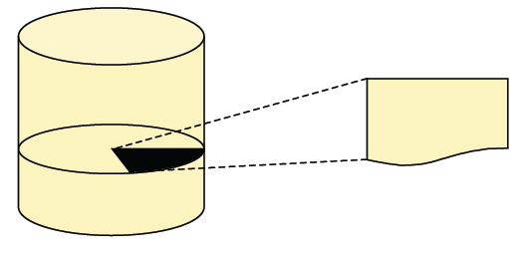
Abstraction
Abstraction is about hiding details
a file on a hard disk
mapped to a collection of sectors and tracks on the disk
we don't directly address disk layout when accessing the file
a level of abstraction provides a simplified interface to underlying resources

Slide 11
Abstraction
Why Abstraction?
it is a key to managing complexity in computer systems
different abstraction levels: hierarchy + interfaces
interfaces simplify your life!
no need to deal with too many details
create a certain level of vendor independence
Abstraction Limitations
diversity reduces interoperability
instruction sets, operating systems, programming languages
operating system designs reduce flexibility
operating systems introduce abstractions for memory, I/O, ...
typical approach: the OS manages resources directly
implicit assumption: all resources under a single regime
limited flexibility wrt. applications, security, failure isolation

Slide 12
Abstraction, Virtualization of Computer System
Virtualization
Similar to Abstraction but it does not always hide low layer’s details
Real system is transformed so that it appears to be different
Virtualization can be applied not only to subsystem, but to an Entire Machine → Virtual Machine
Resource AA
BB
BB’
isomorphism
Resource A
B
B’

Slide 13
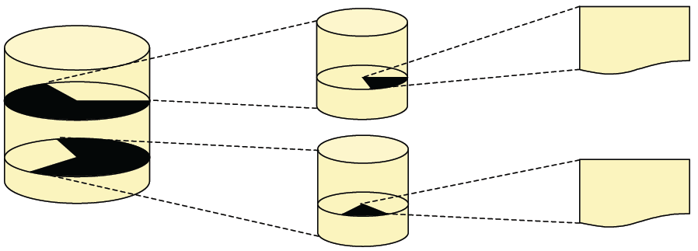
Virtualization
Virtualization is about creating illusions
two files on separate hard disks, each of which is a partition on an actual hard disk
virtualization:
a virtualized system's interface and resources are mapped onto interface and resources of another ("real") system
virtualization provides a different interface and/or resources at the same level of abstraction

Slide 14
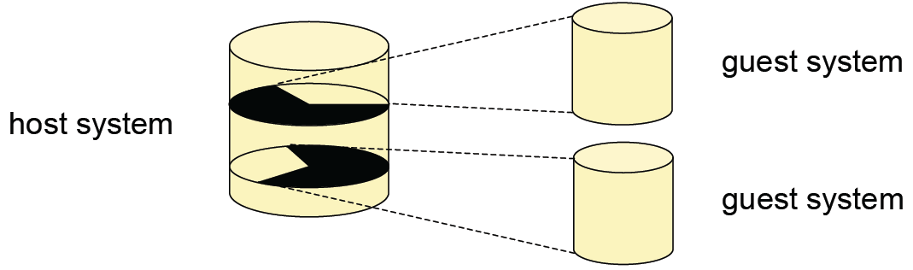
Virtualization
two types of systems involved
the virtualized system is called guest system
the "real" system is called host system
multiple layers of virtualization
virtualized host system is also an option

Slide 15
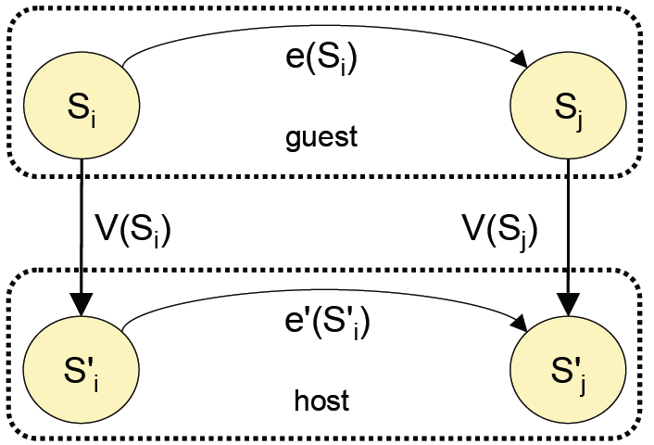
Virtualization
the host is transformed
appears to be a (set of) different virtualized system(s)
introduction of an isomorphism mapping guest to host system
Si, Sj: states in a system
e: operation sequence modifying Si to Sj
V: function mapping guest states to host states
S'i, S'j: host states
e': operation sequence corresponding to e
virtualization vs. abstraction
the same isomorphism can also be used to depict abstraction
important difference: virtualization does not necessarily hide details

Slide 16
What Can be Virtualized
Computers
Storage
Network
Services
Security
… almost everything
What we see the mostly is to virtualize a computer.

Slide 17
Virtual Machine
"Virtual"
what we know now
virtualization is about creating illusions
map interfaces and resources to other interfaces and resources
"Machine"?
what we need to know: notion of "machine"
what is virtualized to build a virtual machine?
what interfaces and resources are there that can be subject to
virtualization?
roadmap
look at computer system architecture
identify (types of) interfaces
identify and characterize virtualization approaches

Slide 18
Virtualization is “HOT”
Microsoft acquires Connectix Corp.
EMC acquires VMware
Veritas acquires Ejascent
IBM, already a pioneer
Sun working hard on it
HP picking up
➔Virtualization is HOT!!!

Slide 19
First Virtualization Classification
ISA based virtualization
ABI based virtualization
API based virtualization

Slide 20
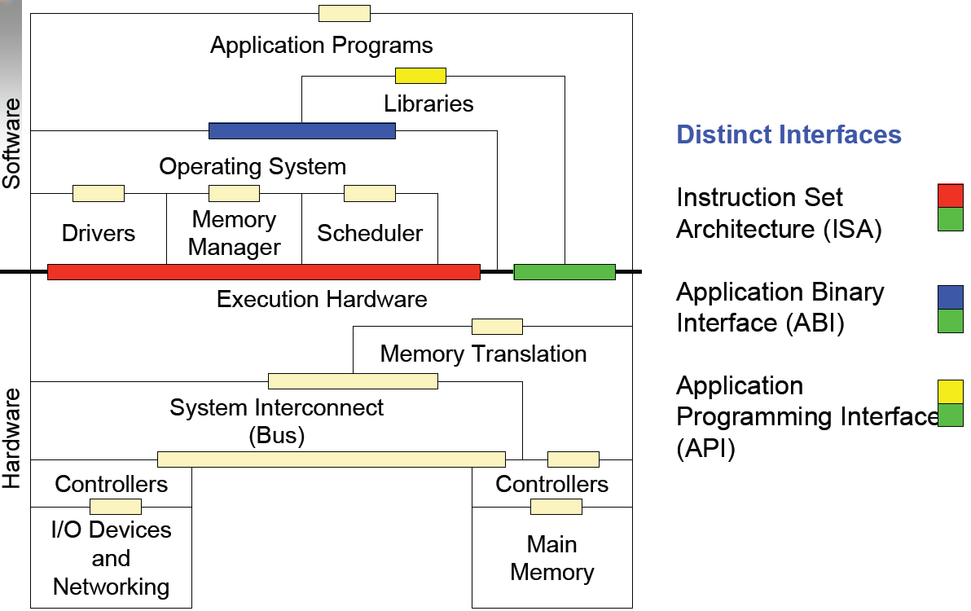
Computer Architecture

Slide 21

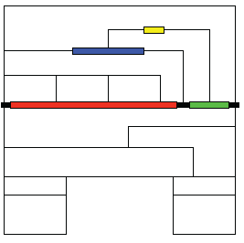

Instruction Set Architecture
division between hardware and software
sub-parts
user ISA parts of the ISA visible to applications
system ISA parts of the ISA visible to supervisor software
system ISA can also employ user ISA components
software compatibility
software built to a given ISA can run on any hardware that supports that ISA

Slide 22

Application Binary Interface (ABI)
provides programs with access to hardware resources and services
major components
set of all user instructions
system calls : indirect interaction with hardware resources
system calls
OS operations performed on behalf of user programs
often includes security checks (wrt. access privileges)
support for portability
binaries compiled to a specific ABI can run unchanged on a system with the same ISA and OS

Slide 23

Application Programming Interface (API)
abstracts from the details of service implementations
usually defined with respect to a high-level language (HLL)
standard library to invoke OS services
typically defined at source code level
support for portability
software using a given API can be ported to other platforms by recompilation

Slide 24
"Machine": Matter of Perspective
Process Perspective
machine = combination of OS and user-level
logical memory address space assigned to the process
user-level registers and instructions for program execution
I/O part of machine visible only through OS; interaction via OS calls
ABI provides process/machine interface
Operating System Perspective
machine is implemented by underlying alone
system: full execution environment for multiple users
processes share file system and other resources
OS is part of the system
ISA provides system/machine interface

Slide 25
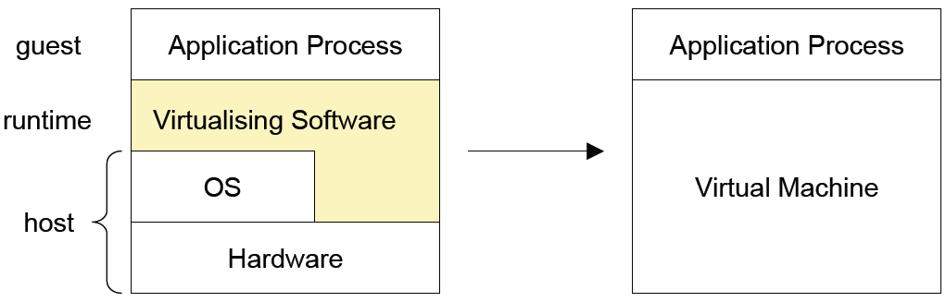
Process Virtual Machines
capable of supporting an individual process
virtualizing software
placed at ABI, on top of OS + hardware
emulates both user-level instructions and OS calls

Slide 26
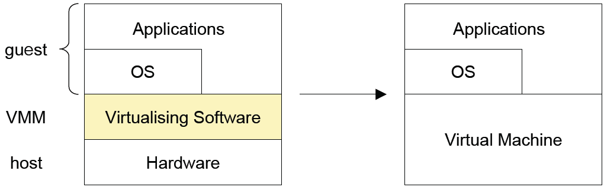
System Virtual Machines
provide a complete system environment
can support a "guest OS" with (probably) many user processes
virtualizing software ("virtual machine monitor", VMM)
placed between underlying hardware and conventional software
ISA translation
alternative approach: hosted VM (virtualizing software built on top of an OS)

Slide 27
Second Virtualization Classification
Instruction Set Architecture
Emulate the ISA in software
Interprets, translates to host ISA (if required)
Device abstractions implemented in software
Inefficient
Optimizations: Caching, Code reorganization.
Applications: Debugging, Teaching, multiple OS
Hardware Abstraction Layer (HAL)
Between “real machine” and “emulator” (maps to real hardware)
Handling non-virtualizable architectures
Applications: Fast and usable, virtual hardware, consolidation, migration

Slide 28
Second Virtualization Classification cont’d
Operating System Level
Virtualized SysCall Interface
May or may not provide all the device abstractions
Easy to manipulate (create, configure, destroy)
Library (user-level API) Level
Presents a different subsystem API to application
Complex implementation, if kernel API is limited
User-level device drivers
Application (Programming Language) Level
Virtual architecture (ISA, registers, memory, …)
Platform-independence (➔ highly portable)
Less control on the system (extremely high-level)

Slide 29
Overall Picture
 | ISA | HAL | OS | Library | PL
Performance | * | **** | **** | *** | **
Flexibility | **** | *** | ** | ** | **
Ease of Impl | ** | * | *** | ** | **
Degree of Isolation | *** | **** | ** | ** | ***
(more stars are better)

Slide 30
Instruction Set Architecture Level Virtualization
Technologies
Emulation: Translates guest ISA to native ISA
Emulates h/w specific IN/OUT instructions to mimic a device
Translation Cache: Optimizes emulation by making use of similar recent instructions
Code rearrangement
Speculative scheduling (alias hardware)
Issues
Efficient Exception handling
Self-modifying code

Slide 31
ISA Level Virtualization: Examples
Applications
Bochs: Open source x86 emulator
Emulates whole PC environment
x86 processor and most of the hardware (VGA, disk, keyboard, mouse, …)
Custom BIOS, emulation of power-up, reboot
Host ISAs: x86, PowerPC, Alpha, Sun, and MIPS
Crusoe (Transmeta)
“Code morphing engine” – dynamic x86 emulator on VLIW processor
16 MB “translation cache”
Shadow registers: Enables easy exception handling
QEMU:
Full Implementation
Multiple target ISAs: x86, ARM, PowerPC, Sparc
Supports self-modifying code
Full-software and simulated (using mmap()) MMU
User-space only: Useful for Cross-compilation and cross-debugging
OS
Old ISA
Codesigned VM
New ISA
New hardware

Slide 32
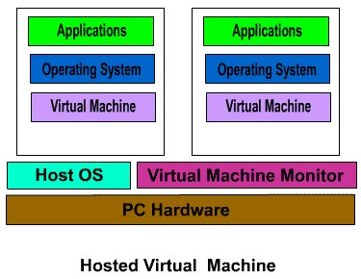
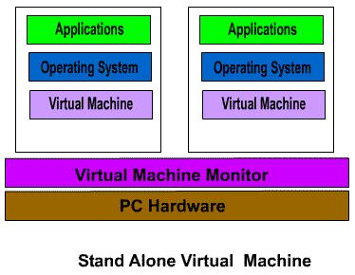
HAL Virtualization Techniques
Standalone vs. Hosted
Drivers
Host and VMM worlds
I/O
Protection Rings
Multilevel privilege domains
Handling “silent” fails
Scan code and insert/replace artificial traps
Cache results to optimize

Slide 33
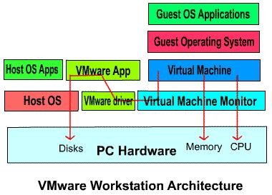
VMware Architecture

Slide 34
VMware: I/O Virtualization
VMM does not have access to I/O
I/O in “host world”
Low level I/O instructions (issued by guest OS) are merged to high-level I/O system calls
VM Application executes I/O SysCalls
VM Driver works as the communication link between VMM and VM Application
World switch needs to “save” and “restore” machine state
Additional techniques to increase efficiency

Slide 35
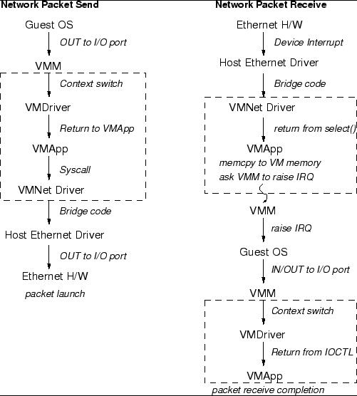

Slide 36
Paravirtualization
Traditional architectures do not scale
Interrupt handling
Memory management
World switching
Virtualized architecture interface
Much simpler architectural interface
Virtual I/O and CPU instructions, registers, …
Portability is lost

Slide 37
Paravirtualizing the Memory Management Unit (MMU)
Guest OS allocate and manage own page-tables
Hypercalls to change PageTable base.
Xen Hypervisor is responsible for trapping accesses to the virtual page table, validating updates and propagating changes.
Xen must validate page table updates before use
Updates may be queued and batch processed
Validation rules applied to each PTE
Guest may only map pages it owns
XenoLinux implements a balloon driver
Adjust a domain’s memory usage by passing memory pages back and forth between Xen and XenoLinux

Slide 38
Examples
Denali
Simpler customized OS with no VM for network applications
Xen
Simpler port to commercial OS
Exposes some “real” hardware, e.g. clock, physical memory address

Slide 39
OS Level Virtualization
Containers (operating environments) on top of OS
Processes, File System, Network resource (IP address), Environment variables, System call interface
Technologies
chroot(): File system virtualization on Unix
Name spaces: Each container is tagged and new entities (fork()) generated from a container remains inside
System call interposition: The only interface with user space, can modify parameters, return values (to expose a different environment)
Copy-on-write: Enables sharing of files
Applications: Sandboxing, Fine grain access control (root in the container)

Slide 40
OS Level Virtualization: Examples
Jail
FreeBSD based virtualization using “chroot()”
Scope is limited to the jail
Curtailed access to resources and operations
Signals, debugger, IP spoofing, system calls
A file-system sub-tree, one IP address, one “root”
Ensim’s “Virtual Private Server”
Supports virtual “boot”, per-VM resource limits
Virtual /proc, IP address-space
Linux “Virtual Environment” (VE)
Tagged VE (VE-id), policy support for the rights of “root”

Slide 41
Library Level Virtualization
Technologies
API interception through DLL hooking
Partial/complete implementation of APIs
Emulate low level kernel implementations in user-space
Useful when the host OS does not provide required support (e.g. Win32 threads vs. pthreads)
Mandatory drivers
Examples
WINE: Win32 API implementation on Unix/X
POSIX, OS/2 subsystems on Windows
Supports Unix and OS/2 like API
LxRun: Linux API implementation on SCO UnixWare, Solaris
WABI: Sun’s implementation similar to WINE (not extensive)

Slide 42
Windows Architecture
Executables
Applications
POSIX,
OS/2
Subsystem
Windows DLLs
Windows DLLs
User32.DLL, …
Gdi32.DLL, User32.DLL,…
Kernel32.DLL
Kernel32.DLL
NTDLL.DLL
Win9x Kernel
NT Kernel & Executive
Low-Level Drivers
Low-Level Drivers

Slide 43
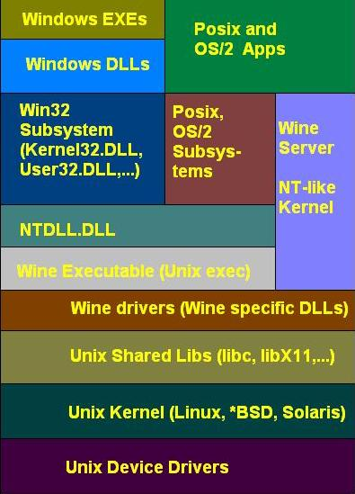
Wine Architecture
Closely follows NT
Implements all the “core” DLLs (ntdll, user32, kernel32)
Wine server provides the NT backbone
Message passing
Synchronization
Object handles
Native DLL support for non-core libraries
Hardware access through Unix device drivers

Slide 44
WINE Implementation
Wine server
IPC through Unix sockets and shared message queues
Process/Thread management
Simulates Synchronization primitives
Native vs. Built-in DLLs
DLLs are implemented as Unix shared libraries (built-in DLLs)
Supports non-core Windows DLLs (Native DLLs)
A fully implemented built-in DLL takes precedence over native DLLs
Executable Load
DLL descriptors table maintain the list of loaded DLLs
Imports are resolved using DLL descriptor table or on-disk DLLs
Processes/Threads
Windows processes are mapped to WINE/UNIX processes
Thread-related APIs implemented in user-space and using pthreads

Slide 45
Application Level Virtualization
Java Virtual Machine (JVM)
Executes Java byte code (virtual instructions)
Provides the implementation for the instruction set interpreter (or JIT compiler)
Provides code verification, SEH, garbage collection
Hardware access through underlying OS
JVM Architecture
Stack-based architecture
No MMU
Virtual hardware: PC, register-set, heap, method (code) areas
Rich instruction set
Direct object manipulation, type conversion, exception throws
Provides a runtime environment through JRE
Other Examples: .NET CLI, Parrot (PERL 6)

Slide 46
Type | Description | Advantages | Disadvantages
Emulation | The hypervisor presents a complete virtual machine (of a foreign computing architecture to the host) enabling foreign applications to run in the emulated environment. | Simulates hardware that is not physically available. | Low performance and low density
Full | The hypervisor provides a complete virtual machine (of the same computing architecture as the host) enabling unmodified guests to run isolation. | Flexibility-run different versions of different operating systems from multiple vendors. | Guest OS does not know that it is being virtualized. Can incur a sizable performance hit on commodity hardware, particularly for I/O intensive applications.
Para | The hypervisor provides a complete but specialized virtual machine (of the same computing architecture as the host) to each guest allowing modified guests to run in isolation. | Lightweight and fast, near native speeds: Demonstrated to operate in the 0.5%-3.0% overhead range. [http://www.cl.cam.ac.uk/research/srg/netos/papers/2003-xensosp.pdf] Allows OS to cooperate with hypervisor – improves IO and resource scheduling. Allows virtualizing architecture that do not support full virtualization. | Requires porting quest OS to use hypercalls instead of sensitive instructions. The main limitataion of paravirtualization is the guest OS must be tailored specifically to run on top of the virtual machine monitor(VMM), the host program that support multiple, identical execution environments. This especially impacts legacy closed source operating systems that have not yet implemented paravirtualized extensions.
OS level | A single operating system is modified in such a way as to allow various user space server processes to be coalesced into functional unites, which are executed in isolation from one another while running on a single hardware platform. | Fast, lightweight virtualization layer. It has the best possible (that is, close to native) performance and density, and features dynamic resource and management. | In practice, strong isolation is difficult to implement. Requires the same OS and patch level on all virtualized machines (homogeneous computing infrastructure).
Library | Emulates operating systems or subsystems via a special software library. Does not provide the illusion of a stand-alone system with a full operating system. | Provides missing API for application developers. | Often performs more slowly than a native optimized port of the application.
Application | Applications run in a virtual execution environment that provides a standard API for cross-platform execution and manages the application’s consumption of local resources. | Manages resources automatically, which eases programmer learning curve. Increase portability of applications. | Execution is slower than native code. Overhead of virtual machine incurred when compared to native code.

Slide 47
Third Classification: Two types of hypervisors
Definitions
Hypervisor (or VMM – Virtual Machine Monitor) is a software layer that allows several virtual machines to run on a physical machine
The physical OS and hardware are called the Host
The virtual machine OS and applications are called the Guest
Type 1 (bare-metal)
Type 2 (hosted)
VM1
VM2
Guest
Guest
VM1
VM2
Process
Hypervisor
Hypervisor
OS
Host
Host
Hardware
Hardware
VMware ESX, Microsoft Hyper-V, Xen
VMware Workstation, Microsoft Virtual PC, Sun VirtualBox, QEMU, KVM

Slide 48
Bare-metal or hosted?
Bare-metal
Has complete control over hardware
Does not have to “fight” an OS
Hosted
Avoid code duplication: need not code a process scheduler, memory management system – the OS already does that
Can run native processes alongside VMs
Familiar environment – how much CPU and memory does a VM take? Use top! How big is the virtual disk? ls –l
Easy management – stop a VM? Sure, just kill it!
A combination
Mostly hosted, but some parts are inside the OS kernel for performance reasons
E.g., KVM

Slide 49







Evolution of Software solutions*
1st Generation: Full virtualization (Binary rewriting)
Software Based
VMware and Microsoft
2nd Generation: Paravirtualization
Cooperative virtualization
Modified guest
VMware, Xen
3rd Generation: Silicon-based (Hardware-assisted) virtualization
Unmodified guest
VMware and Xen on virtualization-aware hardware platforms
Virtual
Machine
Virtual
Machine
…
Dynamic Translation
VM
…
VM
Virtual
Machine
Virtual
Machine
Hypervisor
…
Operating System
Hypervisor
Hardware
Hardware
Hardware
Time
*This slide is from Intel® Corporation
Virtualization Logic

Slide 50
I/O Virtualization

Slide 51
I/O Virtualization
We saw methods to virtualize the CPU
A computer is more than a CPU
Also need I/O!
Types of I/O:
Block (e.g., hard disk)
Network
Input (e.g., keyboard, mouse)
Sound
Video
Most performance critical (for servers):
Network
Block

Slide 52
Side note – How does a NIC (network interface card) driver work?
Transmit path:
OS prepares packet to transmit in a buffer in memory
Driver writes start address of buffer to register X of the NIC
Driver writes length of buffer to register Y
Driver writes ‘1’ (GO!) into register T
NIC reads packet from memory addresses [X,X+Y) and sends it on the wire
NIC sends interrupt to host (TX complete, next packet please)
Receive path:
Driver prepares buffer to receive packet into
Driver writes start address of buffer to register X
Driver writes length of buffer to register Y
Driver writes ‘1’ (READY-TO-RECEIVE) into register R
When packet arrives, NIC copies it into memory at [X,X+Y)
NIC interrupts host (RX)
OS processes packet (e.g., wake the waiting process up)

Slide 53
I/O Virtualization? Emulate!
Hypervisor implements virtual NIC (by the specification of a real NIC, e.g., Intel, Realtek, Broadcom)
NIC registers (X, Y, Z, T, R, …) are just variables in hypervisor (host) memory
If guest writes ‘1’ to register T, hypervisor reads buffer from memory [X,X+Y) and passes it to physical NIC driver for transmission
When physical NIC interrupts (TX complete), hypervisor injects TX complete interrupt into guest
Similar for RX path

Slide 54
I/O Virtualization? Emulate!
Pro:
Unmodified guest (guest already has drivers for Intel NICs…)
Cons:
Slow – every access to every NIC register causes a VM exit (trap to hypervisor)
Hypervisor needs to emulate complex hardware
Example hypervisors: QEMU, KVM, VMware (without VMware Tools)

Slide 55
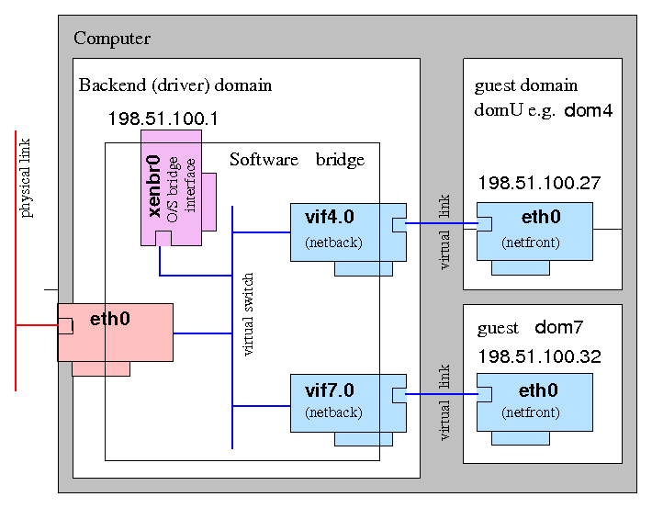
I/O Virtualization? Paravirtualize!
Add virtual NIC driver into guest (frontend)
Implement the virtual NIC in the hypervisor (backend)
Everything works just like in the emulation case…
…except – protocol between frontend and backend
Protocol in emulation case:
Guest writes registers X, Y, waits at least 3 nano-sec and writes to register T
Hypervisor infers guest wants to transmit packet
Paravirtual protocol:
Guest does a hypercall, passes it start address and length as arguments
Hypervisor knows what it should do
Paravirtual protocol can be high-level, e.g., ring of buffers to transmit (so NIC doesn’t stay idle after one transmission), and independent of particular NIC registers

Slide 56
I/O Virtualization? Paravirtualize!
Pro:
Fast – no need to emulate physical device
Con:
Requires guest driver
Example hypervisors: QEMU, KVM, VMware (with VMware Tools), Xen
How is paravirtual I/O different from paravirtual guest?
Paravirtual guest requires to modify whole OS
Try doing it on Windows (without source code), or even Linux (lots of changes)
Paravirtual I/O requires the addition of a single driver to a guest
Easy to do on both Windows and Linux guests

Slide 57
I/O Virtualization? Direct access / direct assignment!
“Pull” NIC out of the host, and “plug” it into the guest
Guest is allowed to access NIC registers directly, no hypervisor intervention
Host can’t access NIC anymore

Slide 58
I/O Virtualization? Direct access / direct assignment!
Pro:
As fast as possible!
Cons:
Need NIC per guest
Plus one for host
Can’t do “cool stuff”
Encapsulate guest packets, monitor, modify them at the hypervisor level
Example hypervisors: KVM, Xen, VMware

Slide 59
I/O Virtualization? Emerging standard – SR-IOV!
Single root I/O virtualization
Contains a physical function controlled by the host, used to create virtual functions
Each virtual function is assigned to a guest (like in direct assignment)
Each guest thinks it has full control of NIC, accesses registers directly
NIC does multiplexing/demultiplexing of traffic

Slide 60
I/O Virtualization? Emerging standard – SR-IOV!
Pros:
As fast as possible!
Need only one NIC (as opposed to direct assignment)
Cons:
Emerging standard
Few hypervisors fully support it
Expensive!
Requires new hardware
Can’t do “cool stuff”
Example hypervisors: KVM, Xen, VMware

Slide 61
Industry trends on I/O virtualization
SR-IOV is the fastest, however it is the most expensive solution
Paravirtual I/O is cheap, but much worse performance
Companies (Red Hat, IBM, …) are looking at paravirtual I/O, trying to optimize it

Slide 62
Virtual Machine Monitor (VMM)

Slide 63
Concepts
References and Sources
James Smith, Ravi Nair, “The Architectures of Virtual Machines,” IEEE Computer, May 2005, pp. 32-38.
Mendel Rosenblum, Tal Garfinkel, “Virtual Machine Monitors: Current Technology and Future Trends,” IEEE Computer, May 2005, pp. 39-47.
L.H. Seawright, R.A. MacKinnon, “VM/370 – a study of multiplicity and usefulness,” IBM Systems Journal, vol. 18, no. 1, 1979, pp. 4-17.
S.T. King, G.W. Dunlap, P.M. Chen, “Operating System Support for Virtual Machines,” Proceedings of the 2003 USENIX Technical Conference, June 9-14, 2003, San Antonio TX, pp. 71-84.
A. Whitaker, R.S. Cox, M. Shaw, S.D. Gribble, “Rethinking the Design of Virtual Machine Monitors,” IEEE Computer, May 2005, pp. 57-62.
G.J. Popek, and R.P. Goldberg, “Formal requirements for virtualizable third generation architectures,” CACM, vol. 17 no. 7, 1974, pp. 412-421.

Slide 64
Definitions
Virtual Machine Monitor (VMM)
A virtualization system that partitions a single physical “machine” into multiple virtual machines.
Terminology
Host – the machine and/or software on which the VMM is implemented
Guest – the OS which executes under the control of the VMM

Slide 65
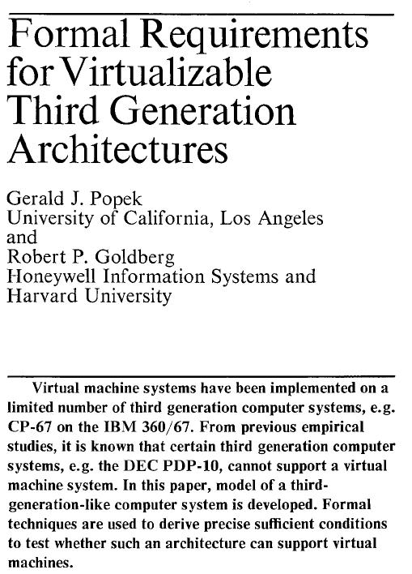
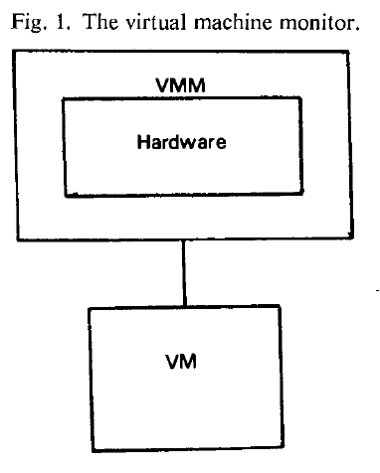
Origins - Principles
“an efficient, isolated duplicate of the real machine”
Efficiency
Innocuous instructions should execute directly on the hardware
Resource control
Executed programs may not affect the system resources
Equivalence
The behavior of a program executing under the VMM should be the same as if the program were executed directly on the hardware (except possibly for timing and resource availability)
Communications of the ACM, vol 17, no 7, 1974, pp.412-421

Slide 66
Origins - Principles
Instruction types
Privileged
an instruction traps in unprivileged (user) mode but not in privileged (supervisor) mode.
Sensitive
Control sensitive –
attempts to change the memory allocation or privilege mode
Behavior sensitive
Location sensitive – execution behavior depends on location in memory
Mode sensitive – execution behavior depends on the privilege mode
Innocuous – an instruction that is not sensitive
Theorem
For any conventional third generation computer, a virtual machine monitor may be
constructed if the set of sensitive instructions for that computer is a subset of the set of privileged instructions.
Signficance
The IA-32/x86 architecture is not virtualizable.

Slide 67
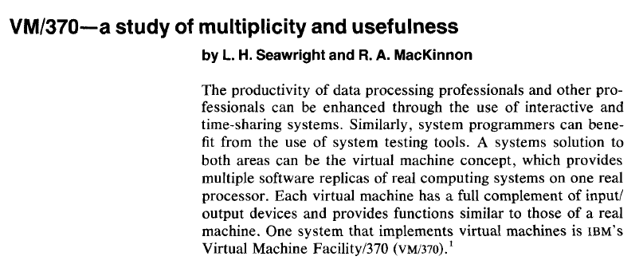
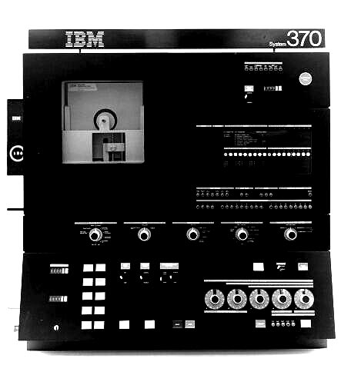
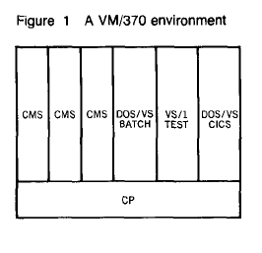
Origins - Technology
IBM Systems Journal, vol. 18, no. 1, 1979, pp. 4-17.
Concurrent execution of multiple production operating systems
Testing and development of experimental systems
Adoption of new systems with continued use of legacy systems
Ability to accommodate applications requiring special-purpose OS
Introduced notions of “handshake” and “virtual-equals-real mode” to allow sharing of resource control information with CP
Leveraged ability to co-design hardware, VMM, and guestOS

Slide 68
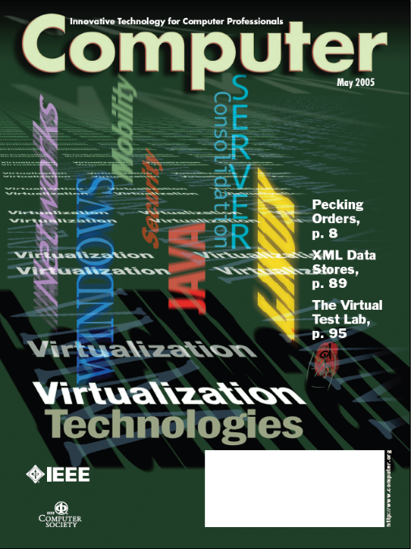
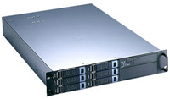
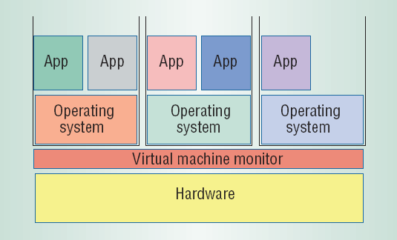
VMMs Rediscovered
Application
Application
Application
Guest OS
Guest OS
Guest OS
Virtual Machine
Virtual Machine
Virtual Machine
VMM
Real Machine
Server/workload consolidation (reduces “server sprawl”)
Compatible with evolving multi-core architectures
Simplifies software distributions for complex environments
“Whole system” (workload) migration
Improved data-center management and efficiency
Additional services (workload isolation) added “underneath” the OS
security (intrusion detection, sandboxing,…)
fault-tolerance (checkpointing, roll-back/recovery)

Slide 69
Architecture & Interfaces
Architecture: formal specification of a system’s interface and the logical behavior of its visible resources.
API
Applications
Libraries
System Calls
ABI
Operating
System
ISA
System ISA
User ISA
Hardware
API – application binary interface
ABI – application binary interface
ISA – instruction set architecture

Slide 70
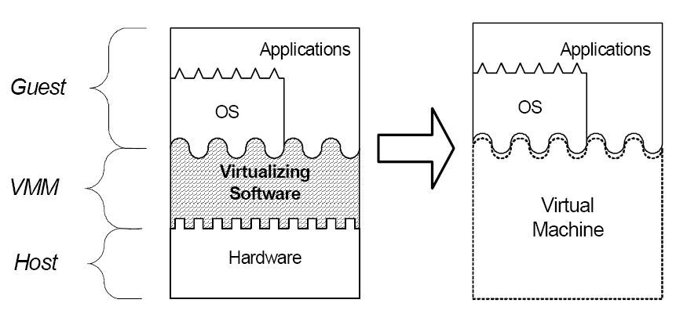
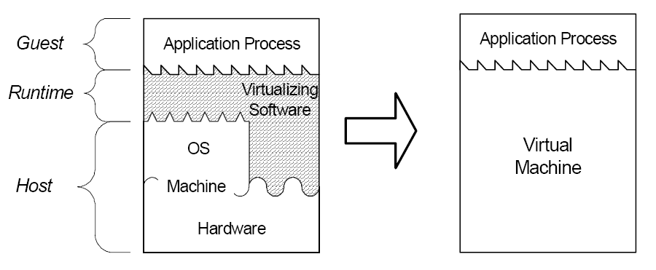
VMM Types
System
Provides ABI interface
Efficient execution
Can add OS-independent services (e.g., migration, intrustion detection)
Process
Provides API interface
Easier installation
Leverage OS services (e.g., device drivers)
Execution overhead (possibly mitigated by just-in-time compilation)

Slide 71
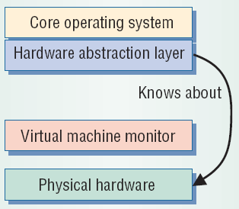
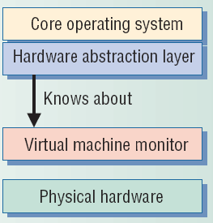
System-level Design Approaches
Full virtualization (direct execution)
Exact hardware exposed to OS
Efficient execution
OS runs unchanged
Requires a “virtualizable” architecture
Example: VMWare
Paravirtualization
OS modified to execute under VMM
Requires porting OS code
Execution overhead
Necessary for some (popular) architectures (e.g., x86)
Examples: Xen, Denali

Slide 72
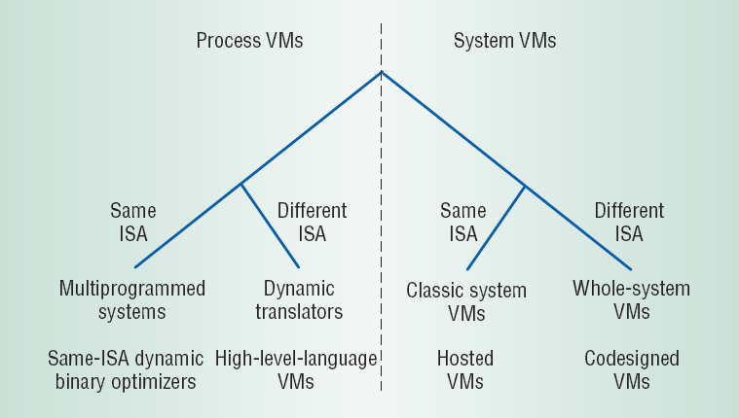
Design Space (level vs. ISA)
API interface
ABI interface
Variety of techniques and approaches available
Critical technology space highlighted

Slide 73
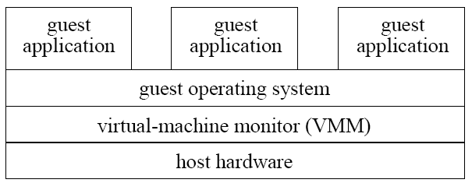
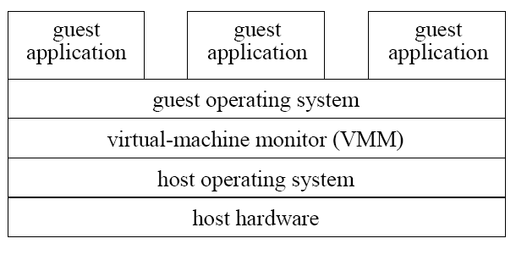
System VMMs
Type 1
Structure
Type 1: runs directly on host hardware
Type 2: runs on HostOS
Primary goals
Type 1: High performance
Type 2: Ease of construction/installation/acceptability
Examples
Type 1: VMWare ESX Server, Xen, OS/370
Type 2: User-mode Linux
Type 2

Slide 74
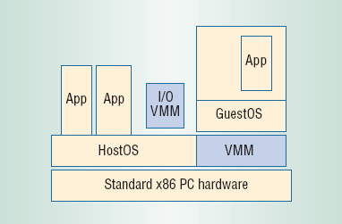
Hosted VMMs
Structure
Hybrid between Type1 and Type2
Core VMM executes directly on hardware
I/O services provided by code running on HostOS
Goals
Improve performance overall
leverages I/O device support on the HostOS
Disadvantages
Incurs overhead on I/O operations
Lacks performance isolation and performance guarantees
Example: VMWare (Workstation)

Slide 75
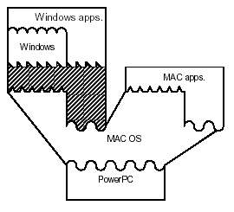
Whole-system VMMs
Challenge: GuestOS ISA differs from HostOS ISA
Requires full emulation of GuestOS and its applications
Example: VirtualPC

Slide 76
Strategies
De-privileging
VMM emulates the effect on system/hardware resources of privileged instructions whose execution traps into the VMM
aka trap-and-emulate
Typically achieved by running GuestOS at a lower hardware priority level than the VMM
Problematic on some architectures where privileged instructions do not trap when executed at deprivileged priority
Primary/shadow structures
VMM maintains “shadow” copies of critical structures whose “primary” versions are manipulated by the GuestOS
e.g., page tables
Primary copies needed to insure correct environment visible to GuestOS
Memory traces
Controlling access to memory so that the shadow and primary structure remain coherent
Common strategy: write-protect primary copies so that update operations cause page faults which can be caught, interpreted, and emulated.
GuestOS
privileged
instruction
trap
resource
emulate change
vmm
change
resource

Slide 77
Memory Management
VMM
machine
OS
physical
process
virtual
entity
address space
VMM
GuestOS
Isolation/protection of Guest OS address spaces
Efficient MM address translation
“shadow” page tables
page tables

